Slide 1
Unit-IV Packages
Contents:-
Defining a Package
Finding packages and CLASSPATH
Important Packages
Access protection
importing packages
Wrapper Classes, Boxing and Unboxing conversions
1

Slide 2
Packages:
Package:
A package is a container of classes and interfaces. A package represents a directory that contains related group of classes and interfaces.
For example, when we write statements like:
import java.io.*;
Here we are importing classes of java.io package. Here, java is a directory name and io is
another sub directory within it. The ‘*’ represents all the classes and interfaces of that io
sub directory.
We can create our own packages called user-defined packages or extend the available packages. User-defined packages can also be imported into other classes and used exactly in the same way as the Built-in packages. Packages provide reusability.
General form for creating a package: package packagename; e.g.: package pack;
The first statement in the program must be package statement while creating a package

Slide 3
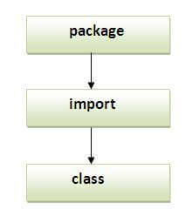
Packages:
Package:
While creating a package except instance variables, declare all the members and the class itself as public then only the public members are available outside the package to other programs.
Advantage of Java Package
  Java package is used to categorize the classes and interfaces so that they can be easily maintained.
  Java package provides access protection.
  Java package removes naming collision.
Note: Sequence of the program must be package then import then class.

Slide 4
Packages:
Package:
Another way to run this program by -classpath switch of java:
The -classpath switch can be used with javac and java tool.
Program 1: Write a program to create a package pack with Addition class.
Code-1: Compile: - javac -d . Addition.java
The –d option tells the Java compiler to create a separate directory and place the .class file in that directory (package). The (.) dot after –d indicates that the package should be created in the current directory. So, package pack with Addition class is ready.
Program 2: Write a program to use the Addition class of package pack.
Code-2:

Slide 5
Packages:
Package:
Program 2: Write a program to use the Addition class & Subtraction class of package pack.
Code-3:
Program 4: Write a program to access all the classes in the package pack.
To import all the classes and interfaces in a class using import pack.*;
Code-4:
Note : In this case, please be sure that any of the Addition.java and Subtraction.java programs will not exist in the current directory. Delete them from the current directory as they cause confusion for the Java compiler. The compiler looks for byte code in Addition.java and Subtraction.java files and there it gets no byte code and hence it flags some errors.

Slide 6
Packages:
Creating sub Package:
We can create sub package in a package in the format:
package packagename.subpackagename;
e.g.: package pack1.pack2;
Here, we are creating pack2 subpackage which is created inside pack1 package. To use the classes and interfaces of pack2, we can write import statement as:
import pack1.pack2;
Program 5: Program to show how to create a subpackage in package.
Compile: - javac –d . Sample.java
Code-5:

Slide 7
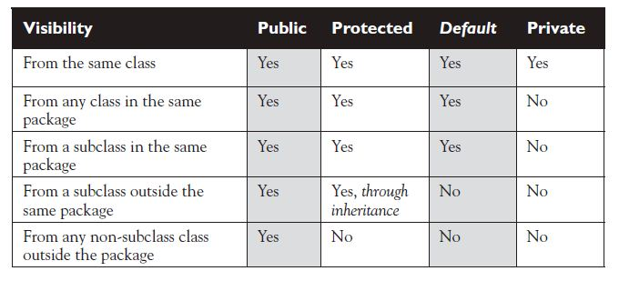
Packages:
Access Specifier: Specifies the scope of the data members, class and methods.
private members of the class are available within the class only.
public members of the class are available anywhere.
default members of the class are available within the class, outside the class and in its sub class of same package. It is not available outside the package.
protected members of the class are available within the class, outside the class and in its sub class of same package and also available to subclasses in different package also.

Slide 8
Packages:
Program 6: Write a program to create class A with different access specifiers.
Code-6
Program 7: Write a program for creating class B in the same package.
Code-7
Program 8: Write a program for creating class C of another package.
Code-8

Slide 9
Wrapper Class:
The variable of normal data type are send to any method are sent by Value. Hence, No two methods in a memory can refer same instance of normal variable in memory. But sometimes it becomes necessary that we want multiple methods to refer the same instance of variable in memory. For this purpose we need to convert a variable of normal data type to object, this is done by wrapper class. Wrapper class wraps the normal data type and convert them to object.
Wrapper class in java provides the mechanism to convert primitive into object and object into primitive.
Primitive Type | Wrapper Class
boolean | Boolean
char | Character
byte | Byte
short | Short
int | Integer
long | Long
float | Float
double | Double

Slide 10
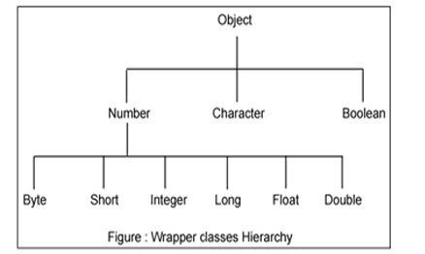
Wrapper Class:
Autoboxing and Unboxing feature converts primitive into object and object into primitive automatically. The automatic conversion of primitive into object is known as Autoboxing and vice-versa Unboxing.
Hierarchy :

Slide 11
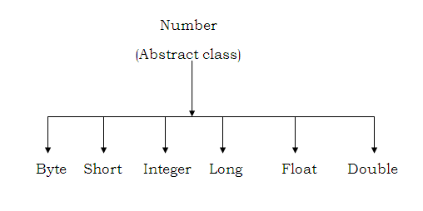
Wrapper Class:
Number Class:
Methods of Number class:
byte byteValue();
short shortValue();
int intValue();
long longValue();
float floatValue();
double doubleValue();

Slide 12
Wrapper Class:
Constructor of Integer Class:
Integer( int i)
Integer(String str) throws NumberFormatException
Method :
int intValue();
Constructor of Character class:
Chracter( char ch)
Method
char charValue();
Constructor of Boolean class:
Boolean( Boolean b)
Boolean( string str)
Method
boolean booleanValue();

Slide 13
Wrapper Class:
Static Methods of 'Integer' class:--
i) parseInt():-- static int parseInt(String str)
ii) toBinaryString():-- String toBinaryString(int i)
iii) toOctalString():-- String toOctalString(int i)
iv) toHexString():-- String toHexString(int i)
Static Methods of 'Character' class:--
i)isDigit() :-- boolean isDigit(char ch)
ii)isLetter():-- boolean isLetter(char ch)
iii)isUpperCase():-- boolean isUpperCase(char ch)
iv)isLowerCase():-- boolean isLowerCase(char ch)
Code-9:
Code-10:

